Slide 1
NE 591: Advanced Reactor Materials
Fall 2021
Dr. Benjamin Beeler

Slide 2
Last Time

Slide 3
advanced cladding

Slide 4
Irradiation Embrittlement
Ferritic steels have these large of monocarbides, which aid in creep resistance
The lath boundaries are decorated with Cr rich M23C6 precipitates which increase the thermal stability of the steel
Embrittlement is caused by 1) segregation of elements to lath boundaries which make the grain boundaries decohesive, and 2) evolution of carbides and intermetallic phases
For removable components such as clad, which are subjected to high temperature and pressure with a residence time of a few years, creep embrittlement is the issue which decides their design and performance
The increase in the ductile to brittle transition temperature, DBTT, is known to be related to irradiation hardening, which is generally observed to saturate with fluence

Slide 5
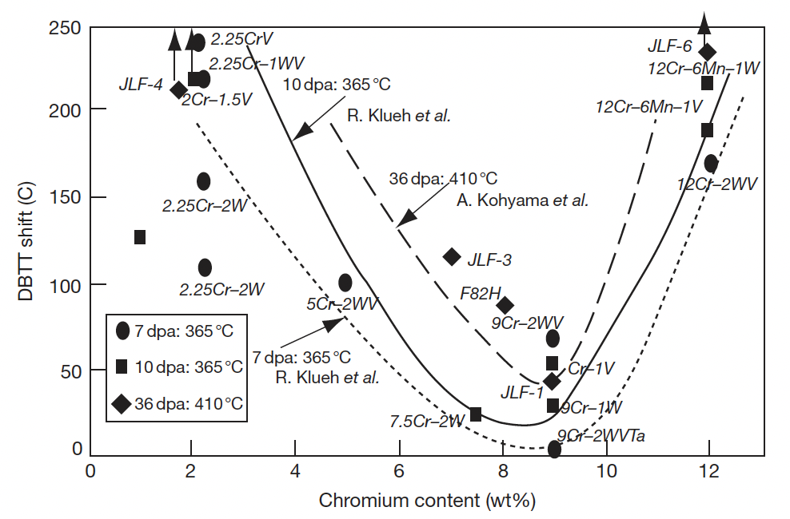
Irradiation Embrittlement
Extensive evaluation of the embrittlement behavior of the ferritic steels for different chemistry has been performed

Slide 7
ODS Steels

Slide 8
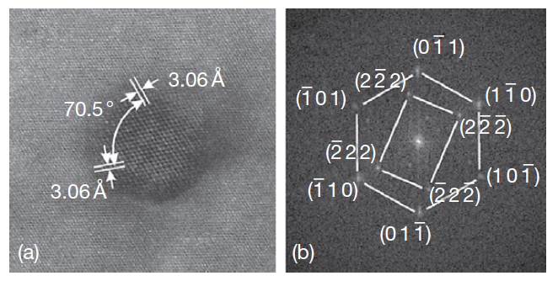
Oxide Dispersion Strengthened

